Slide 1


CAPSTONE PROJECT MySQL
ARVIND K

Slide 2
PROJECT INTRODUCTION
The objective of the Capstone is to demonstrate the ability to use
MySQL
Python
Tableau
We are provided with different business scenarios that we need to analyze using these three technologies, explain our methodology and derive a conclusion
MySQL
python
tableau

Slide 3
DESCRIPTION OF DATASET
MovieOnRent is a chain of movie rental stores operating in a certain country. It has a vast collection of movies in DVD and Blue Ray disc formats. The management of the company wants to analyze what kind of movies are most often rented, which genres they belong to, and which actors appeared in them
We use the Sakila database to perform the required analysis
The database contains 14 tables with data related to films, actors, and rental information

Slide 4
DATA DICTIONARY
The actor Table: The actor table contains information for all actors.
The address Table: The address table contains the address information of the customers
The category Table: The category table lists the categories that can be assigned to a film. The category table is joined to the film table through the film_category table.
The city Table: The city table contains a list of cities.
The country Table: The country table contains a list of countries.
The customer Table: The customer table contains a list of all customers.
The film Table: The film table is a list of all the films in the stores. The film table is joined to the actor table through the film_actor table.
The film_text Table: The film_text table contains the film_id, title, and description columns of the film table
The inventory Table: The inventory table contains one row for each copy of a given film in a given store.
The language Table: The language table is a lookup table listing the possible languages that films can have
The payment Table: The payment table records each payment made by a customer
The rental Table: The rental table contains one row for each rental of each inventory item
The staff Table: The staff table lists all staff members’ information
The store Table: The store table lists all stores in the system

Slide 5
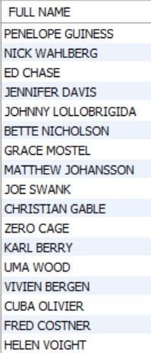
TASK 1
Full names of actors
QUERY
select concat(first_name,' ',last_name) as fullname from actor;
INTERPRETATION
There are 200 actors in the database

Slide 6
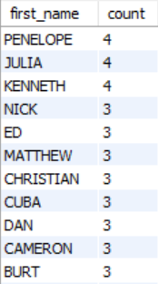
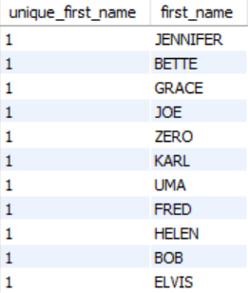
TASK 2
ii. Actors with unique first names
i. Number of times each first name appears
QUERY
QUERY
SELECT first_name, count(*) AS count from actor group by first_name order by count desc;
select count(*) as unique_first_name, first_name from actor group by first_name having count(*) = 1;
INTERPRETATION
The first names that appear the most are Penelope, Julia and Kenneth
There are 76 unique first names in the dataset

Slide 7
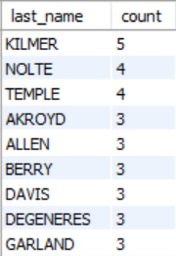
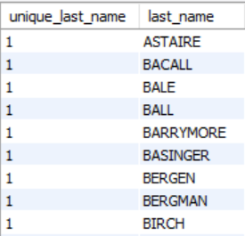
TASK 3
i. Count of last names
ii. Unique last names
QUERY
QUERY
select last_name, COUNT(*) AS count from actor group by last_name order by count desc;
select count(*) as unique_first_name, last_name from actor group by last_name having count(*) = 1;
INTERPRETATION
The last name that appears the most is Kilmer
There are 66 unique last names in the dataset

Slide 8
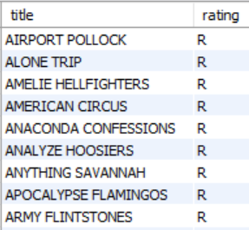
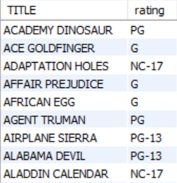
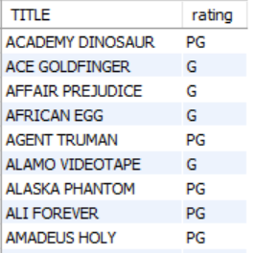
TASK 4
i. Movies with ‘R’ rating ii. Not ‘R’ rated iii. Movies for under 13 years
QUERY
QUERY
QUERY
select title, rating from film where rating ='R';
select title as TITLE, rating from film where rating <>'R';
select title as TITLE, rating from film where rating ='G' or rating ='PG';
INTERPRETATION
There are 195 movies with ‘R’ rating.
There are 805 movies which are not rated ‘R’
There are 372 movies that are suitable for children under 13 years of age

Slide 9
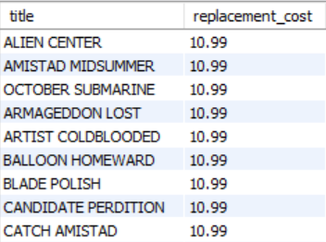
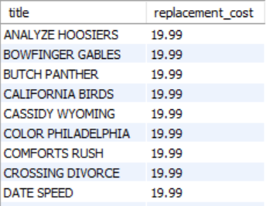
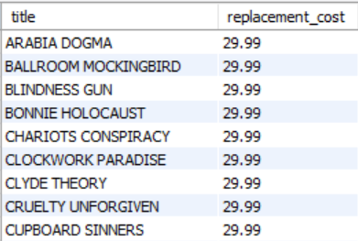
TASK 5
i. Replacement cost is up tp $11
ii. Replacement cost between $11 and $20
iii. Movies with highest to lowest replacement costs
QUERY
QUERY
QUERY
select title, replacement_cost from film where replacement_cost <= 11 order by replacement_cost DESC;
select title, replacement_cost from film where replacement_cost between 11 and 20 order by replacement_cost DESC;
select title, replacement_cost from film order by replacement_cost DESC;
INTERPRETATION
The replacement cost is mostly $10.99 and $9.99
There are 424 movies with replacement cost between $11 and $20
The highest and lowest replacement costs are $29.99 and $9.99

Slide 10
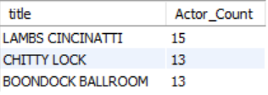
TASK 6
Top 3 movies with the greatest number of actors
QUERY
select F.title, count(FA.actor_id) as Actor_Count from film F join film_actor FA on F.film_id = FA.film_id group by F.film_id order by Actor_Count desc limit 3;
INTERPRETATION
Top 3 movies with the greatest number of actors are Lambs Cincinatti, Chitty lock and Boondock Ballroom

Slide 11
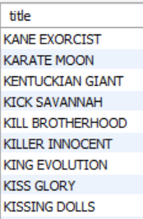
TASK 7
Movies starting with ‘K’ and ‘Q’
QUERY
select title from film where title like 'K%' or title like 'Q%';
INTERPRETATION
There are 15 movies with titles starting with ‘K’ and ‘Q’

Slide 12
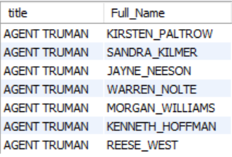
TASK 8
All actors in ‘Agent Truman’
QUERY
select * from actor from film F join film_actor FA on F.film_id = FA.film_id join actor A on A.actor_id = FA.actor_id where title ='Agent Truman';
INTERPRETATION
There are 7 actors who acted in ‘Agent Truman’

Slide 13
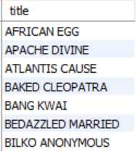
TASK 9
Family Films list
QUERY
select F.title from film F join film_category FC on F.film_id = Fc.film_id join category C on FC.category_id = C.category_id where name ='family';
INTERPRETATION
There are 69 actors in the database that are family friendly

Slide 14
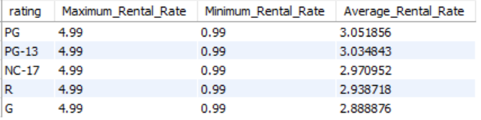
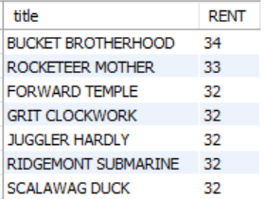
TASK 10
Maximum, minimum and average rental rates based on ratings
ii. Highest to lowest rental frequencies
QUERY
QUERY
select rating,max(rental_rate) as Maximum_Rental_Rate , min(rental_rate) as Minimum_Rental_Rate, avg(rental_rate) as Average_Rental_Rate from filmgroup by rating order by Average_Rental_Rate desc ;
select F.title, count(R.rental_id) as RENT from film F join inventory I on F.film_id = I.film_id join rental R on R.inventory_id = I.inventory_id group by F.film_id order by RENT desc;
INTERPRETATION
For all the ratings, the maximum rental rate is 4.99 and minimum rental rate is 0.99
The highest and lowest rental frequencies are 34 and 4 respectively

Slide 15
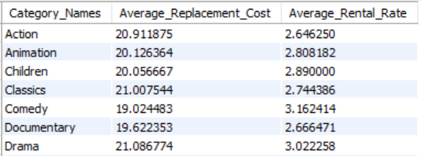
TASK 11
Difference between average film replacement cost and average film rental rate is greater than $15
QUERY
select C.name as Category_Names, avg(F.replacement_cost) as Average_Replacement_Cost, avg(F.rental_rate) as Average_Rental_Rate from film F join film_category FC on F.film_id = FC.film_id join category C on FC.category_id = C.category_id group by C.name having (avg(f.replacement_cost) - avg(f.rental_rate)) > 15;
INTERPRETATION
There are 16 rows with average film replacement cost and average film rental rate greater than $15

Slide 16
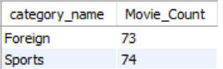
TASK 12
Film categories with number of movies greater than 70
QUERY
select C.name as category_name, count(*) as Movie_Count from film F join film_category FC on F.film_id = FC.film_id join category c on FC.category_id = C.category_id group by C.name having Movie_Count > 70;
INTERPRETATION
Foreign and Sports categories have number of movies greater than 70

Slide 17
THANK YOU

